Slide 1
CSS 161: Fundamentals of Computing Introduction

Slide 2
Outline
What is this course?
Who am I, and why am I here?
Who are you, and why are you here?
Logistics
Introduction to Fundamentals of Computing
Next steps

Slide 3
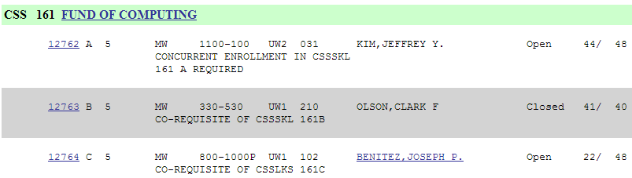
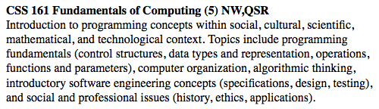
What is this course?

Slide 4
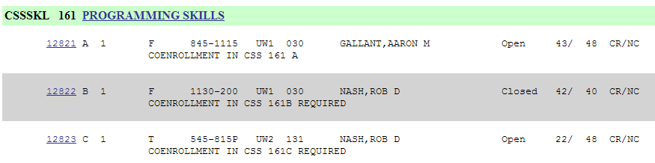
What is this course’s lab?

Slide 5
Who am I, & why am I here?
Joey Benitez
Lecturer,
Computing & Software Systems / Mathematics
MS Mathematics, Colorado State University
Software Developer 30+ years, Century Link
Naming conventions
“Joey”
“Mr. Benitez”

Slide 6
Who are you & why are you here?
Name
Why are you taking this course?
Do you have any programming experience?
If so, which language(s)?
Any experience using an IDE (Integrated Development Environment)?
Something about yourself

Slide 7
THE FIELD (computer science) IS HOT AGAIN
… the number of incoming freshman who listed computer science as their desired major has more than doubled in just 3 years at UW. Western Washington University has seen its computer-science majors double in 2 years…
DEGREE CAN LEAD TO A GOOD JOB
…All of EWU (Eastern Washington University) spring (2013) computer-science grads --- about 90 students --- were offered jobs in Spokane area, and many of those jobs start at $80,000 a year said Steve Simmons, computer-science professor.

Slide 8
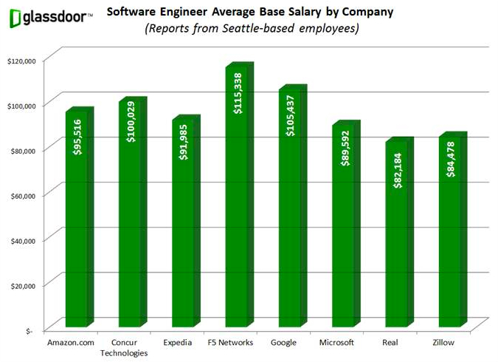
Empowerment … with benefits
http://www.geekwire.com/2012/chart-pays-seattle-software-engineers/

Slide 9
Course Objectives
Learn
programming fundamentals
computer organization
algorithmic thinking
software engineering concepts
social and professional issues

Slide 10
Course Objectives
Learn
programming fundamentals (control structures, data types and representation, I/O operations, functions and parameters … in Java)
computer organization
algorithmic thinking
software engineering concepts
social and professional issues

Slide 11
Course Objectives
Learn
programming fundamentals (control structures, data types and representation, I/O operations, functions and parameters … in Java)
computer organization (hardware, software, CPU, memory, storage, I/O devices, …)
algorithmic thinking
software engineering concepts
social and professional issues

Slide 12
Course Objectives
Learn
programming fundamentals (control structures, data types and representation, I/O operations, functions and parameters … in Java)
computer organization (hardware, software, CPU, memory, storage, I/O devices, …)
algorithmic thinking (clearly specified sequence of steps)
software engineering concepts
social and professional issues

Slide 13
Course Objectives
Learn
programming fundamentals (control structures, data types and representation, I/O operations, functions and parameters … in Java)
computer organization (hardware, software, CPU, memory, storage, I/O devices, …)
algorithmic thinking (clearly specified sequence of steps)
software engineering concepts (specifications, design, testing)
social and professional issues

Slide 14
Course Objectives
Learn
programming fundamentals (control structures, data types and representation, I/O operations, functions and parameters … in Java)
computer organization (hardware, software, CPU, memory, storage, I/O devices, …)
algorithmic thinking (clearly specified sequence of steps)
software engineering concepts (specifications, design, testing)
social and professional issues (history, ethics, applications)

Slide 15
Course Objectives
Learn
programming fundamentals (control structures, data types and representation, I/O operations, functions and parameters … in Java)
computer organization (hardware, software, CPU, memory, storage, I/O devices, …)
algorithmic thinking (clearly specified sequence of steps)
software engineering concepts (specifications, design, testing)
social and professional issues (history, ethics, applications)
Serve: CSS majors, EE majors, general population

Slide 16
Course Objectives
Learn
programming fundamentals (control structures, data types and representation, I/O operations, functions and parameters … in Java)
computer organization (hardware, software, CPU, memory, storage, I/O devices, …)
algorithmic thinking (clearly specified sequence of steps)
software engineering concepts (specifications, design, testing)
social and professional issues (history, ethics, applications)
Serve: CSS majors, EE majors, general population
Work hard, have fun

Slide 17
Logistics
Joey Benitez
Email: jbenite@uw.edu
Use “CSS 161“ in subject
Office: Truly House; Phone: 425-202-5498 google voice
Office hours : MW 6:30-7:45 pm & by appointment
Class meetings
Lectures: MW 8:00 pm - 10:00 pm UW1 - 102
CSSSKL 161 C: T 5:45 pm - 8:15 pm UW2 - 131
Class web site:
http://www.joeybenitez.weebly.com/
Links to lecture notes, assignments, supplemental material,
assignment , dropbox

Slide 18
Grading
Assignments
8 assignments, 35% of grade
Midterm Exams
Based on readings, lectures, discussions, assignments
2 exams, 40% of grade (20% each)
Final Exam
Monday, June 9th, 8:00 pm - 10:00 pm, UW1 - 102
Cumulative, 25% of the grade
UWB Academic Standards will be strictly enforced

Slide 19
UWB Academic Standards
All University of Washington students are expected to conduct themselves as responsible members of the academic community. Among the standards of conduct for UW students includes the responsibility to practice "high standards of academic and professional honesty and integrity." WAC 478-120-020(2) (a).
Academic misconduct includes but is not limited to cheating, facilitation, plagiarism, and fabrication in connection with any exam, research, course assignment, or other academic exercise that contributes, in whole or in part, to the satisfaction of requirements for courses or graduation.
http://www.uwb.edu/academic/policies/academicconduct/student-guide

Slide 20
Attendance & Attention
Attendance is optional
If you attend class, please pay attention in class
If you want to pay attention to other things, please go elsewhere
Please be respectful and courteous to others
No social networking, games, videos, mobile phones

Slide 21
Assignments & Exams
Unless otherwise noted:
All assignments are to be done independently
All assignments must be submitted digitally via the class Catalyst Collect It dropbox
https://catalyst.uw.edu/collectit/dropbox/jbenite/31136
Strict adherence to specifications
File name(s)
Output format
Assignments are due by 11:45 pm on the date they are due
Late assignments – If an assignment is turned in late up to 24 hours after the due date/time you will lose 25% of the points for the given assignment. Assignments turned in after 24 hours of due date will receive a grade of zero.

Slide 22

Required Textbook
Absolute Java, 5th Edition Walter Savitch & Kenrick Mock Addison-Wesley, 2013

Slide 23
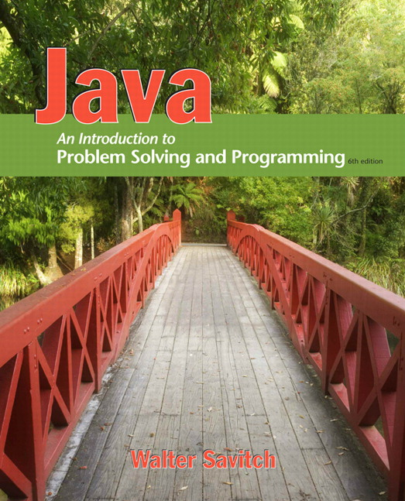
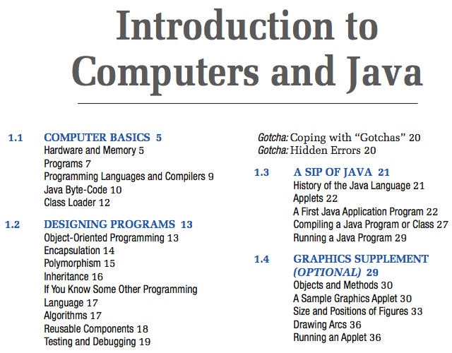
Supplemental Material
Java: An Introduction to Problem Solving & Programming, 6th Edition Walter Savitch, Addison-Wesley, 2012
Course Website: CSS 161/Course Resources/Savitch Webnotes

Slide 24

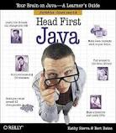
Supplemental Material
Chapter 1, Breaking the Surface
Chapter 2, A Trip to Objectville
Chapter 3, Know Your Variables
Chapter 4, How Objects Behave
Chapter 5, Extra-Strength Methods
Chapter 6, Using the Java Library
Chapter 7, Better Living in Objectville
Chapter 8, Serious Polymorphism
Chapter 9, Life and Death of an Object
Chapter 10, Numbers Matter
Chapter 11, Risky Behavior
Chapter 12, A Very Graphic Story
Chapter 13, Work on Your Swing
Chapter 14, Saving Objects
Chapter 15, Make a Connection
Chapter 16, Data Structures
Chapter 18, Distributed Computing
Head First Java, 2nd Edition Kathy Sierra & Bert Bates O’Reilly Media 2005
http://www.headfirstlabs.com/books/hfjava/

Slide 25
Supplemental Material (All located on course website)
Practice-It!
Coding Practice
Three Java Intro Course
CSS 161/Java Practice and Textbook Websites/Practice It!
CSS 161/Java Practice and Textbook Websites/Coding Practice
CSS 161/Java Practice and Textbook Websites/Java Intro Course
CSS 161/Java Practice and Textbook Websites/Another Java Intro Course
CSS 161/Java Practice and Textbook Websites/And Another Java Intro Course

Slide 26
Approximate Schedule
Date Topic Material Assignment Due
_________________________________________________________________________________________
3/31 Introductions, Discuss website
4/2 Introduction to Java Section 1.1 Assignment A Due 4/5
Expressions, Assignments Statements Section 1.2
Reading Assignment Chapter 1 ( Savitch web notes – Sections 1.1-1.3)
4/7 Program Style, Screen Output Console Input Sections 1.4, 2.1
4/9 Branching Sections 3.1 Assignment 1 Due 4/10
4/14 Console Input Using The Scanner Class Section 2.2, 2.3
4/16 Introduction to File Input, Boolean Expression Section 3.2 Assignment 2 Due 4/17
4/21 Loops Section 3.3
4/23 Debugging, The CLASS String Section 3.4, 1.3 Assignment 3 Due 4/24
4/28 Review
4/30 MIDTERM EXAM 1
5/5 Class Definitions Sections 4.1
5/7 Information Hiding and Encapsulation Sections 4.2 Assignment 4 Due 5/6
5/12 Arrays Section 6.1
5/14 Arrays Section 6.2 Assignment 5 Due 5/15
5/18 LAST DAY TO DROP A COURSE
5/19 Arrays, Review Section 6.3
5/21 MIDTERM EXAM 2 Assignment 6 Due 5/24
5/26 No School
5/28 Arrays, Text Files Section 6.4, 4.4 ________________________
6/2 Constructors Section 10.1, 10.2
6/4 Review Assignment 7 Due 6/6
6/9 FINAL EXAM, Monday June 9th, 8:00 – 10:00 PM in class

